Slide 1
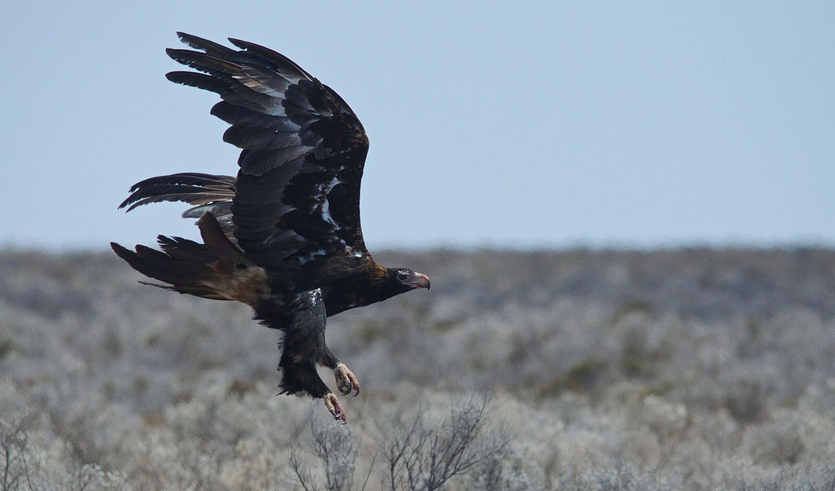
TASMANIAN WEDGE-TAILED EAGLE
Endangered Wedge-tailed Eagle Subspecies

Slide 2
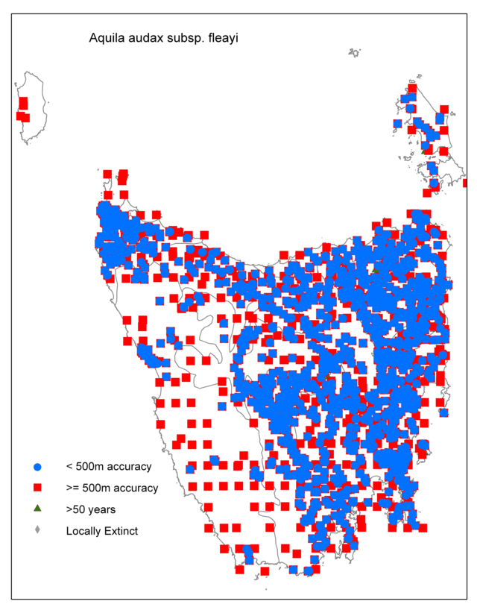
Tasmanian Wedge-Tailed Eagle
Scientific Name: Aquila audax fleayi
Location: Found only in Tasmania and nearby islands.
Has territories that are very widely dispersed across the low and high lands of Tasmania.

Slide 3
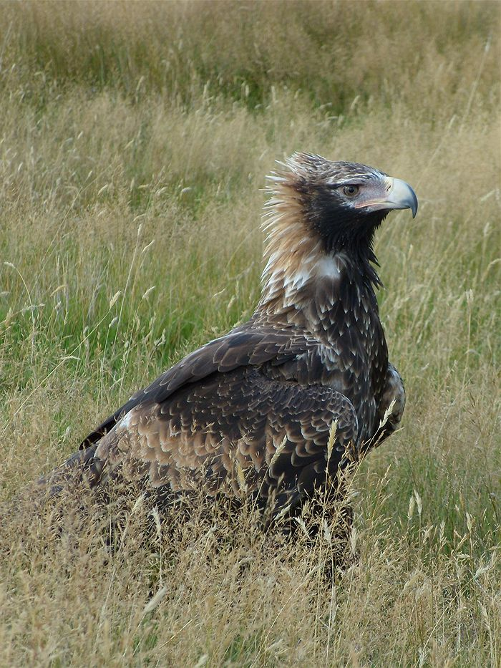
Tasmanian Wedge-Tailed Eagle
Habitat: They have in a variety of habitats, from the sea coast to high alpine regions in the mountains. In general, they prefer open or wooded country, and avoid rainforest and coastal heaths.

Slide 4
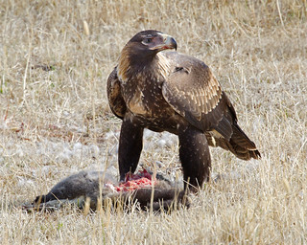
Tasmanian Wedge-Tailed Eagle
Diet: Mainly mammals, lizards and birds, mostly introduced species.
Population: Believed less than 1000 birds remaining with fewer than 80 pairs of eagles successfully breeding each year.

Slide 5
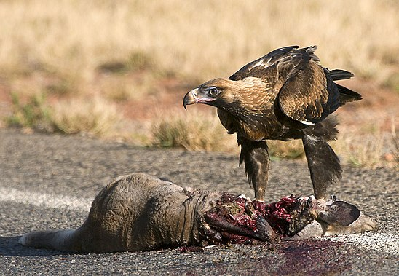
Tasmanian Wedge-Tailed Eagle
Population Threats:
Apex predator but can have conflict with the white-bellied sea eagle over nest-sites
Indirect poisoning from baits
Hunted by landowners
Victim of highway traffic
Habitat loss

Slide 6

Tasmanian Wedge-Tailed Eagle
Intervention:
A Recovery Plan has been put into place by the Tasmanian government.
There are two main objectives:
to identify nesting sites so that they can be protected from further forest clearing
to educate landowners and enlist their support in conservation of wedge-tailed eagles.

Slide 7
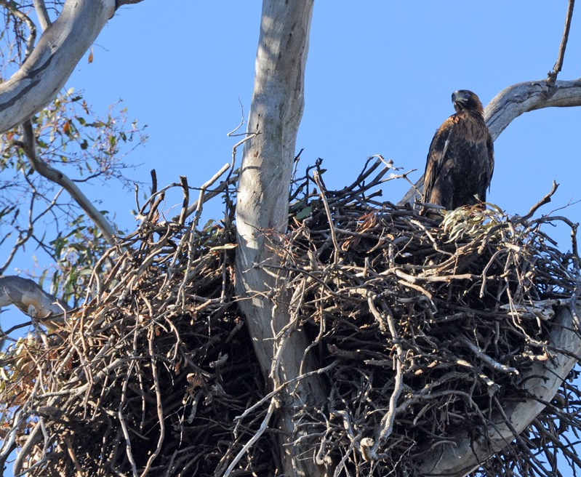
Tasmanian Wedge-Tailed Eagle
Why you should donate:
They have a wingspan of over 2.3m, the largest bird of prey in Australia Plus their nests are 2m in diameter and 4m deep!
They only feed only sickly or dead livestock and are not a threat to the farming industry

Slide 8
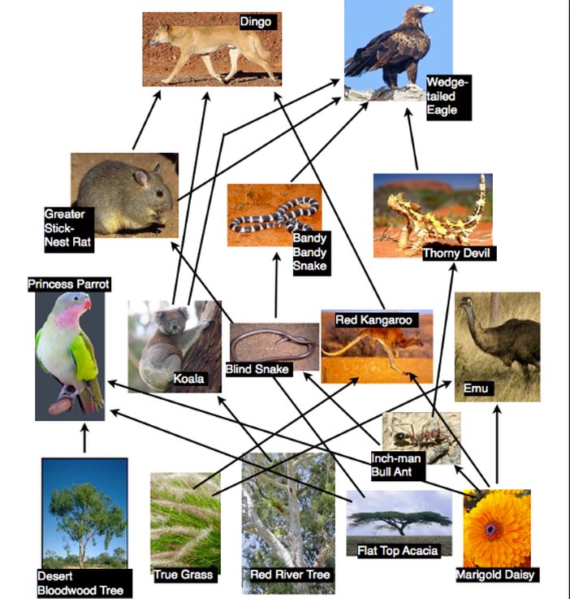
Tasmanian Wedge-Tailed Eagle
Why you should donate:
As scavengers, they keep an ecosystem free of the bodies of dead animals, or carrion, breaking down this organic material and recycle it into the ecosystem as nutrients.
A similar successful recovery plan has been implemented on the mainland for other endangered birds

Slide 9
Tasmanian Wedge-Tailed Eagle
References
https://www.echidnawalkabout.com.au/5-amazing-facts-wedge-tailed-eagle/
https://www.australiangeographic.com.au/news/2018/03/scientists-call-on-the-public-to-look-to-the-sky-to-help-the-tassie-wedge-tailed-eagle/
https://web.archive.org/web/20110304185846/http://environment.gov.au/biodiversity/threatened/publications/recovery/pubs/draft-for-comment-.pdf
https://www.10000birds.com/eastern-curlew-in-australia.htm

